Slide 1

Video Contrast and Sharpness Enhancement
T. Petersen, T. C. Mol, E. Cozza
16/02/2024

Slide 2
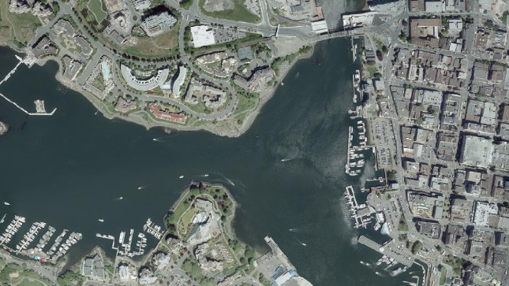
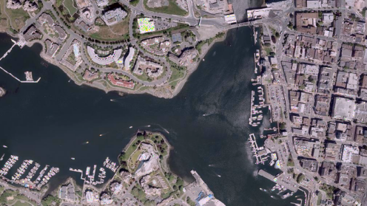
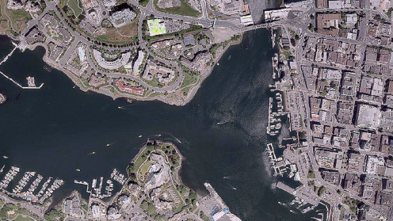
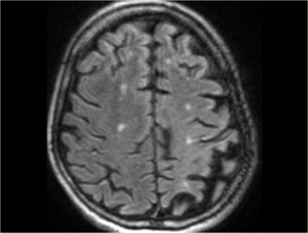
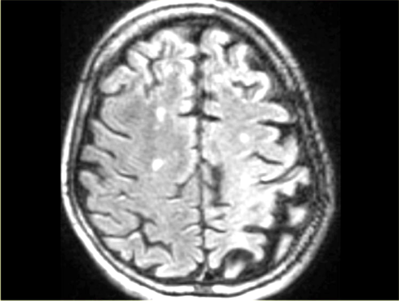
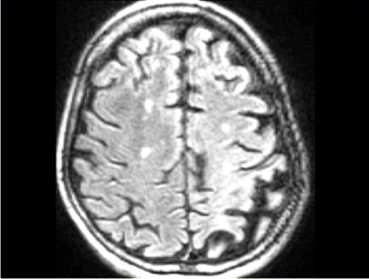


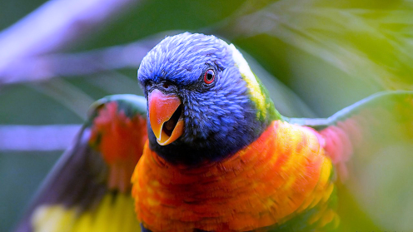
Fields of Application
Satellite Imaging
Medical Imaging
AI and Computer Vision applications
Multimedia applications
Satellite image
MRI

Slide 3
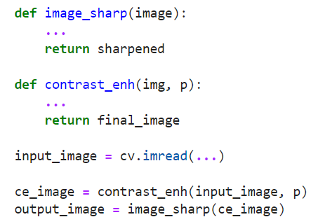
Design Modules
Contrast Enhancement module
Convolution with sharpener filter
Software Implementation
Hardware Implementation
input stream
Contrast
Enhancement
Sharpening
output stream

Slide 4


01
Software Implementation

Slide 5
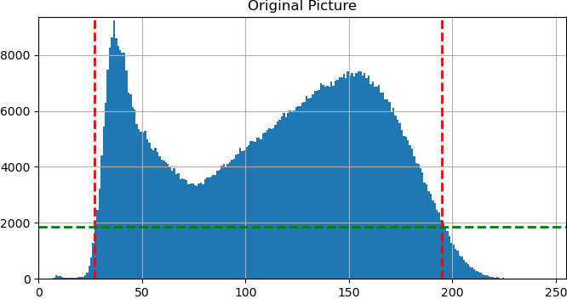
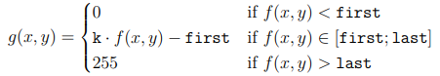
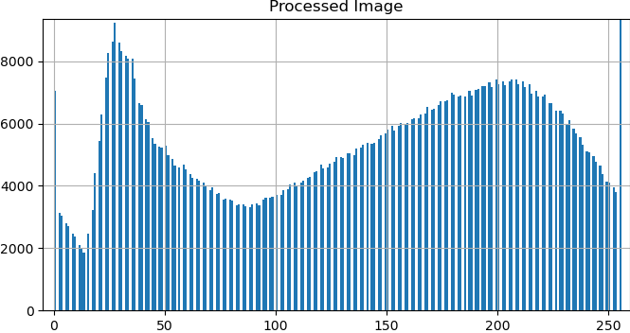
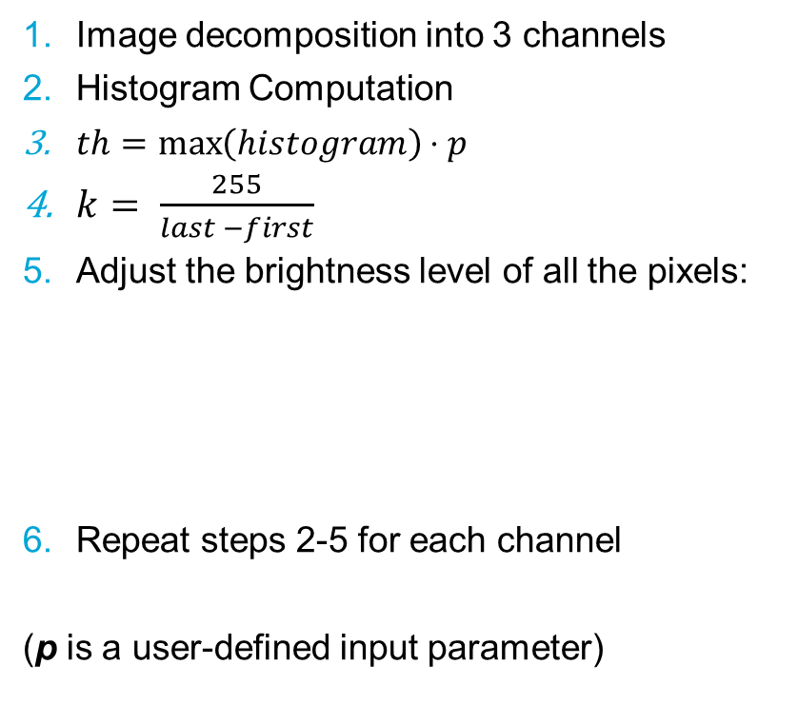
Contrast Enhancement
Image decomposition into 3 channels
Histogram Computation
$th=\max\left(histogram\right)⋅p$
$k= \frac{255}{last −first}$
Adjust the brightness level of all the pixels:
Repeat steps 2-5 for each channel
(p is a user-defined input parameter)
th
first
last

Slide 6

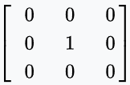
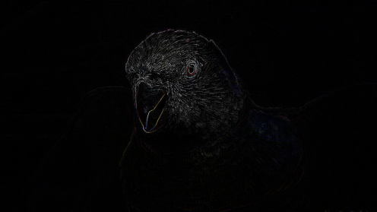
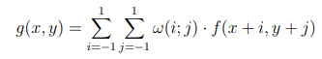
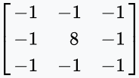
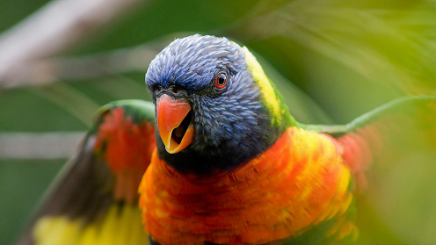
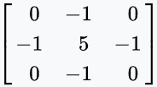
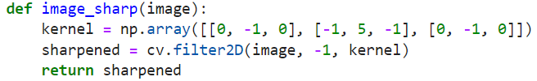
Edge Enhancement
Identity
Based on the convolution operation for a fixed kernel
where:
ω(i;j) is the sharpener filter
f(x,y) is the input image pixel in coordinates (x;y)
g(x,y) is the output image pixel in coordinates (x;y)
Sofware Implementation:
Edge Detection
Sharpen

Slide 7


Results
Contrast Enhancement
Original Picture
Contrast Enhancement + Sharpening

Slide 8
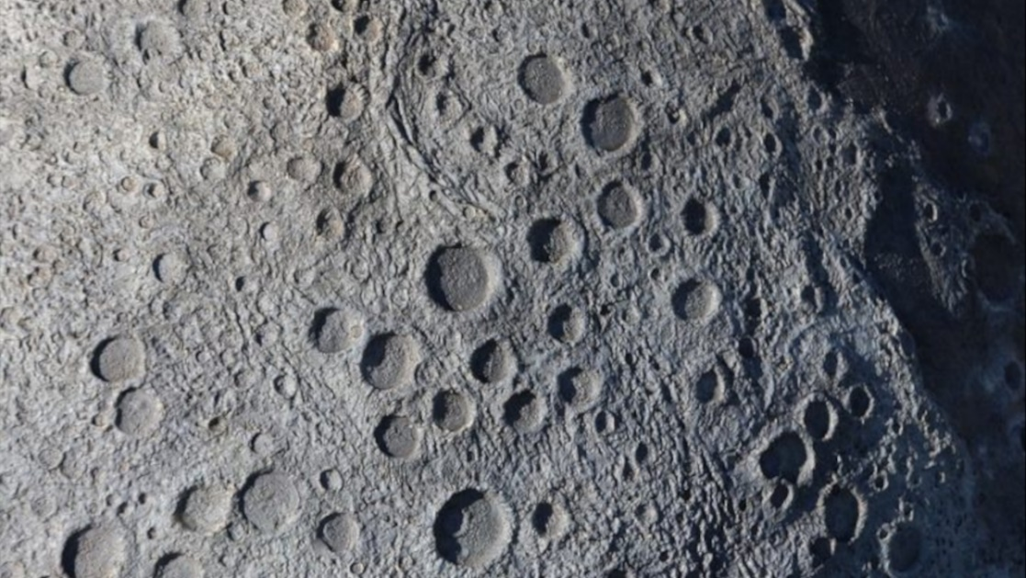
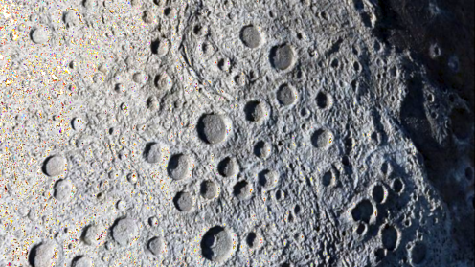
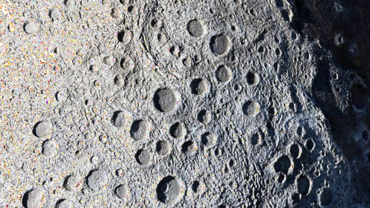
Results
Contrast Enhancement
Original Picture
Contrast Enhancement + Sharpening

Slide 9
Results
Module | Processing time [s/frame] | Frame Rate [frame/s]
Contrast Enhancement | 0.977 | 1.024
Edge Enhancement | 0.218 | 4.588
Total Pipeline | 1.233 | 0.811
Time measurements were recorded for each call to both the contrast and edge enhancement functions during the transmission of 60 frames.
The performances of the final design have been evaluated in terms of (average) processing time per frame and (average) frame rate.

Slide 10


02
Hardware Implementation

Slide 11
Constraint:
Acquisition, processing, and output of 1 pixel per clock cycle
Limitations:
Working on entire frames would require:
Too much memory
Too much latency
Solution:
Stream-Processing approach
Exploit similarities among contiguous frames

Slide 12

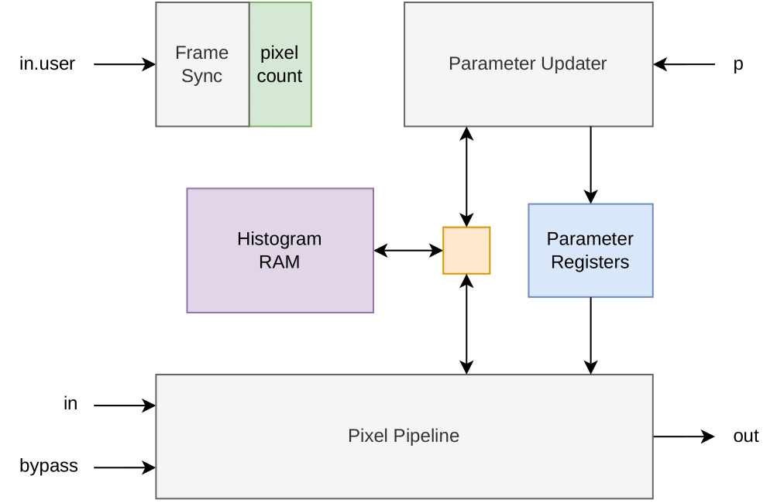
Contrast Enhancement
Pixel Pipeline
Synchronization of computation steps by mean of a pixel counter
Two exclusive phases:
Pixel Pipeline:
Each received pixel increments the histogram count
Apply contrast enhancement according to the parameters evaluated for the previous frame
This phase involves 99.94% of all the frame pixels
Parameters Update:
Reset: reset all the parameter concerning the previous frame
Max: find the maximum value of the histogram for each channel
Th: calculate the threshold
F&L: find first and last
PU: update all the parameters to be used for the next frame.
This phase involves only a portion of the last row of the frame
Reset
Max
Th
F&L
PU
Frame structure depicting the different processing phases.
Top-level diagram of the contrast enhancement module.

Slide 13
Results
Contrast Enhancement
Original Picture
Contrast Enhancement + Sharpening

Slide 14
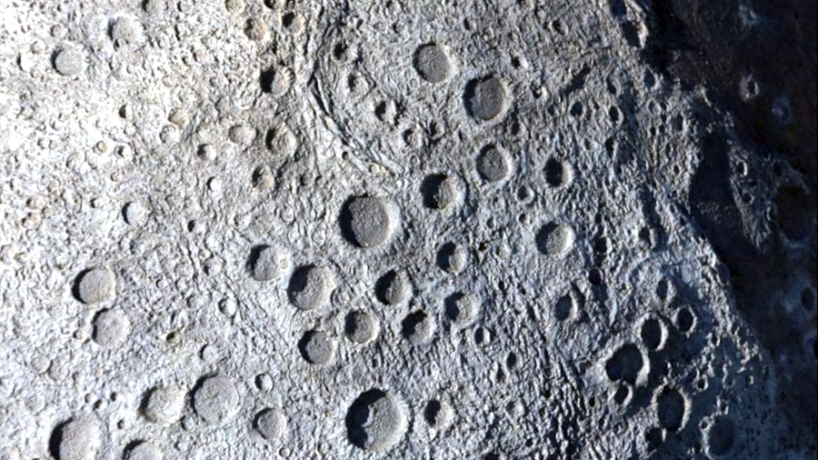
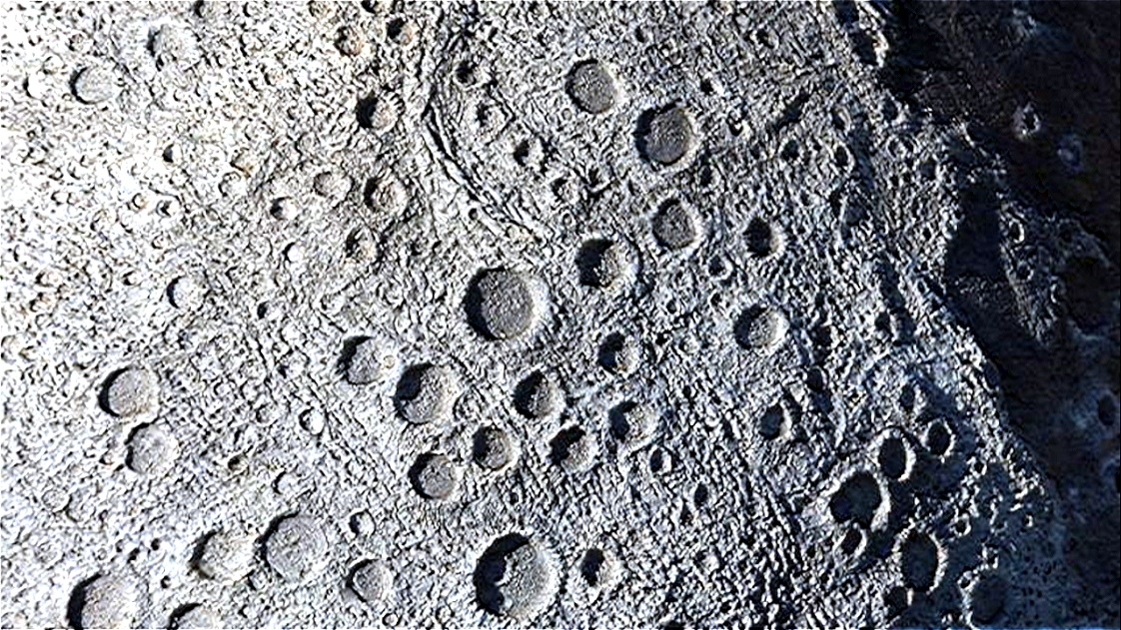
Results
Contrast Enhancement
Original Picture
Contrast Enhancement + Sharpening

Slide 15
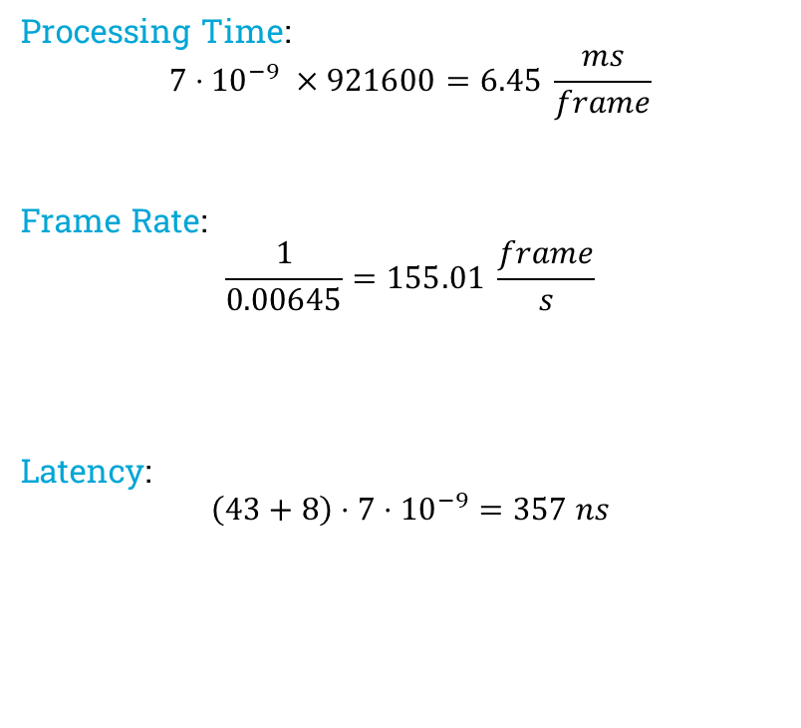
Results
Module | Estimated Clock Period | Pipeline Stages
Contrast Enhancement | 4.961 ± 1.89 ns | 43
Edge Enhancement | 5.081 ± 1.89 ns | 8
Processing Time:
$$7⋅{10}^{−9} ×921600=6.45 \frac{ms}{frame}$$
Frame Rate:
$$\frac{1}{0.00645}=155.01 \frac{frame}{s}$$
Latency:
$$\left(43+8\right)⋅7⋅{10}^{−9}=357 ns$$
Pixel per Frame | 921600
Target Clock Period | 7 ns

Slide 16

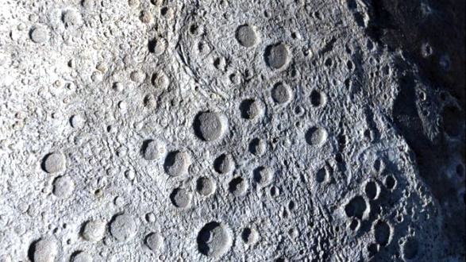
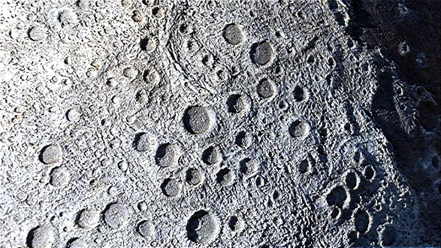
Conclusion
Software Implementation
Hardware solution is approximately 190 times faster than the software implementation.
Hardware solutions require much more design effort with respect to their software counterparts.
Possible approximation errors due to the adoption of fixed point data formats in the hardware solution.
Original Picture
Contrast Enhancement
Edge Enhancement
Hardware Implementation

Slide 17
Thank you for your attention
T. Petersen, T. C. Mol, E. Cozza

